Slide 1

The Ascengers
ASCEND Team #1

Slide 2

Members
Team Lead:
Sam Gonzalez
Housing Engineer:
Samantha Barr
GPS/Ham Radio Engineer:
Derrick Lenhardt
Data/Software Engineers:
Addi Chavez
James Shaffer

Slide 3
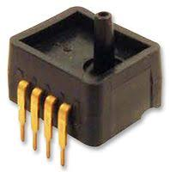
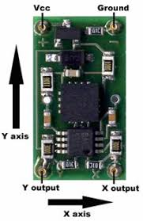
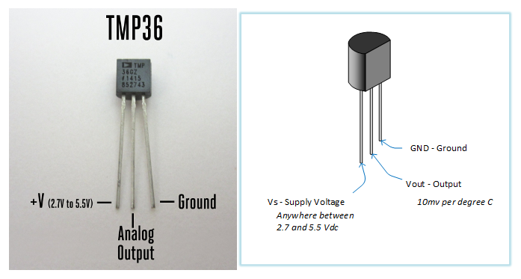
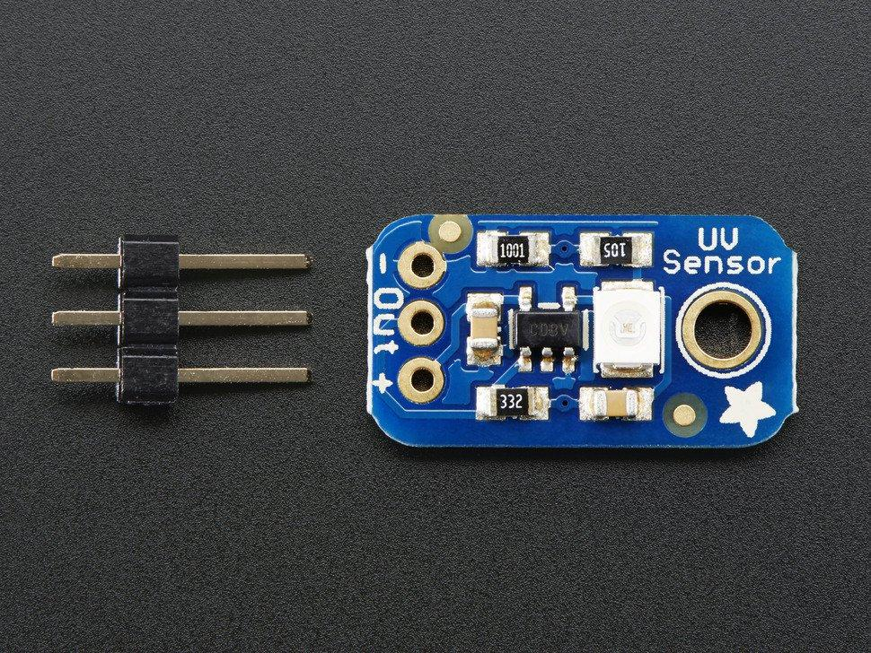
Our Goals:
ASDX Series Pressure Sensor
Fall 2018:
Gather data from sensors
Collect footage of flight
Analog UV Light Sensor Breakout - GUVA-S12SD
TMP 36 Temperature Sensor
DE-ACCM6G Buffered ±6 Accelerometer

Slide 4
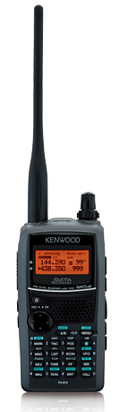
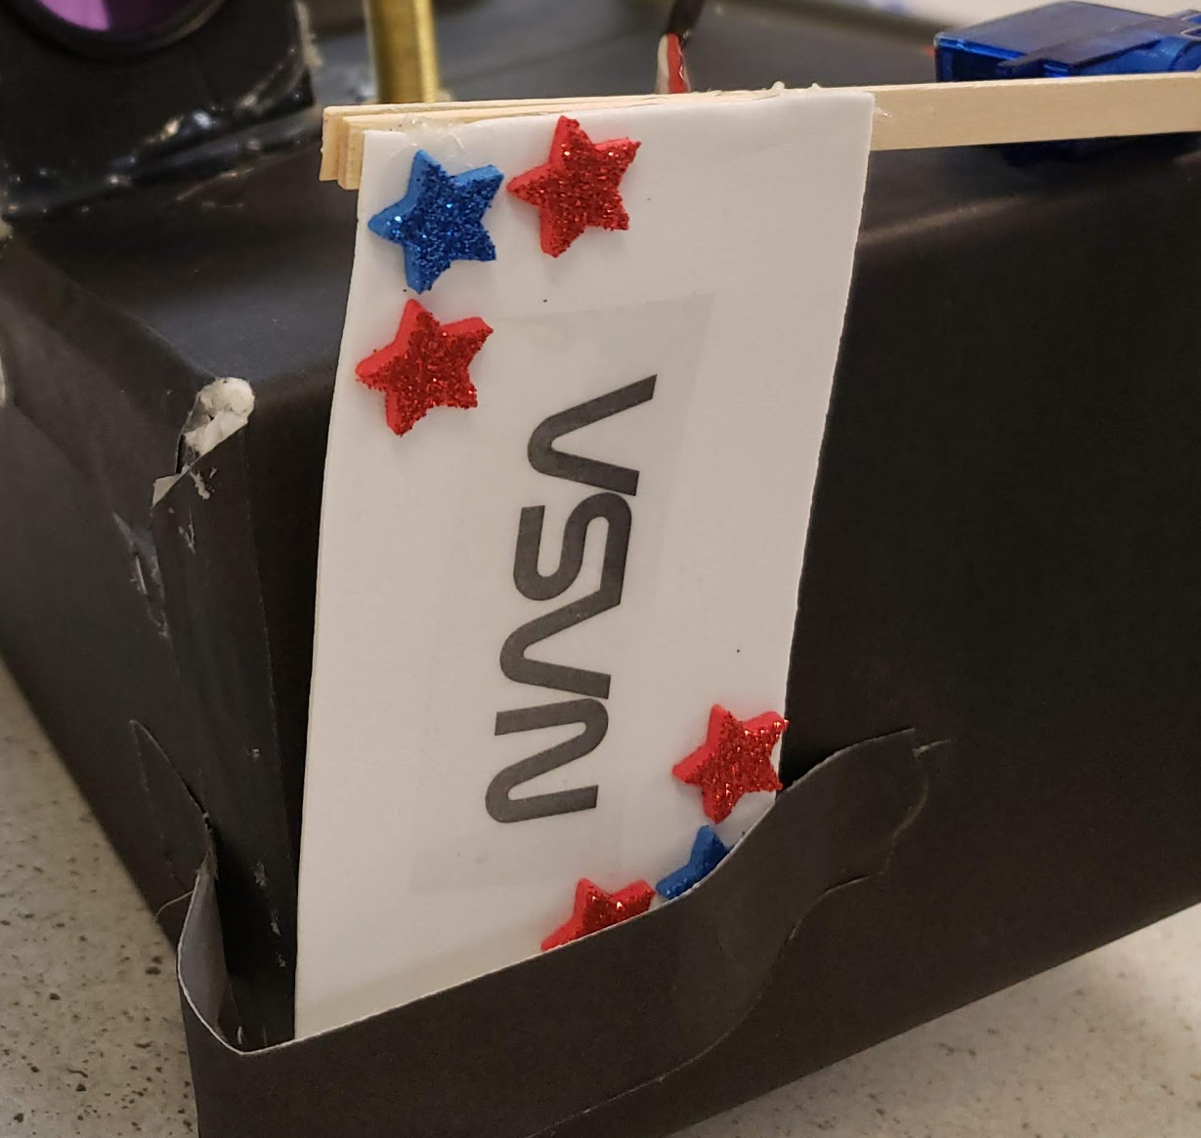
Our Goals:
Spring 2019:
Live GPS data
Utilize pressure reading to perform tasks mid flight

Slide 5
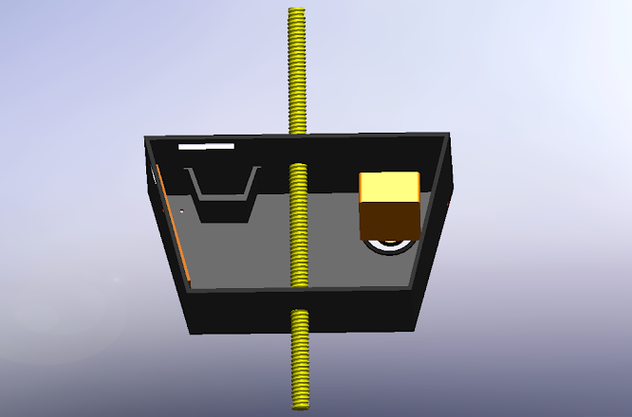
Fall 2018 Housing:
Decided shape for a better camera angle

Slide 6
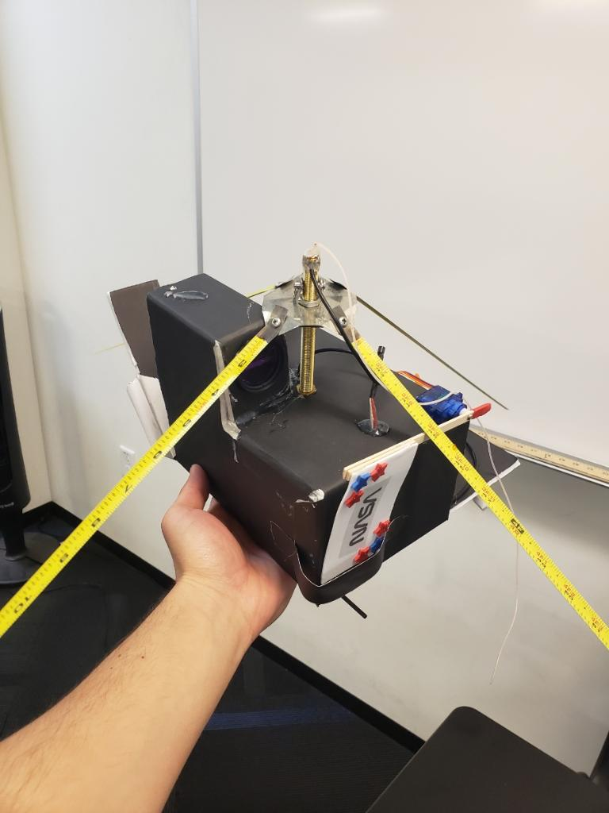
Spring 2019 Housing:
Foam board
Rectangular Prism
Hold internals in place
Place Ham antenna through it
Camera placement

Slide 7
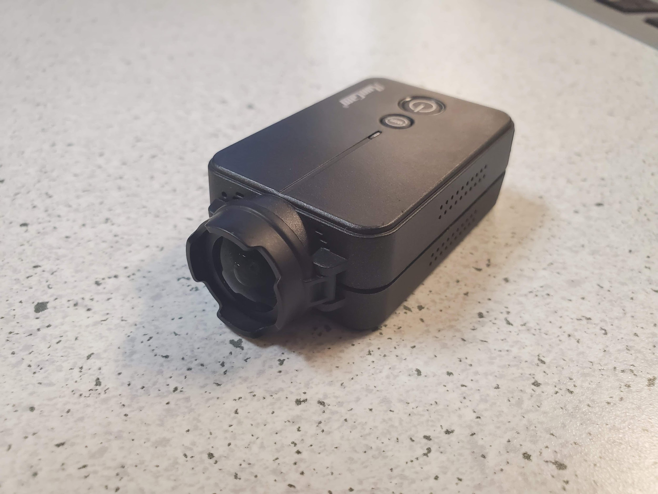
Camera:
Fall 2018: RunCam 2 (Internal Battery)
Spring 2019: RunCam2 (System Battery)
HD sports cam
Lightweight

Slide 8
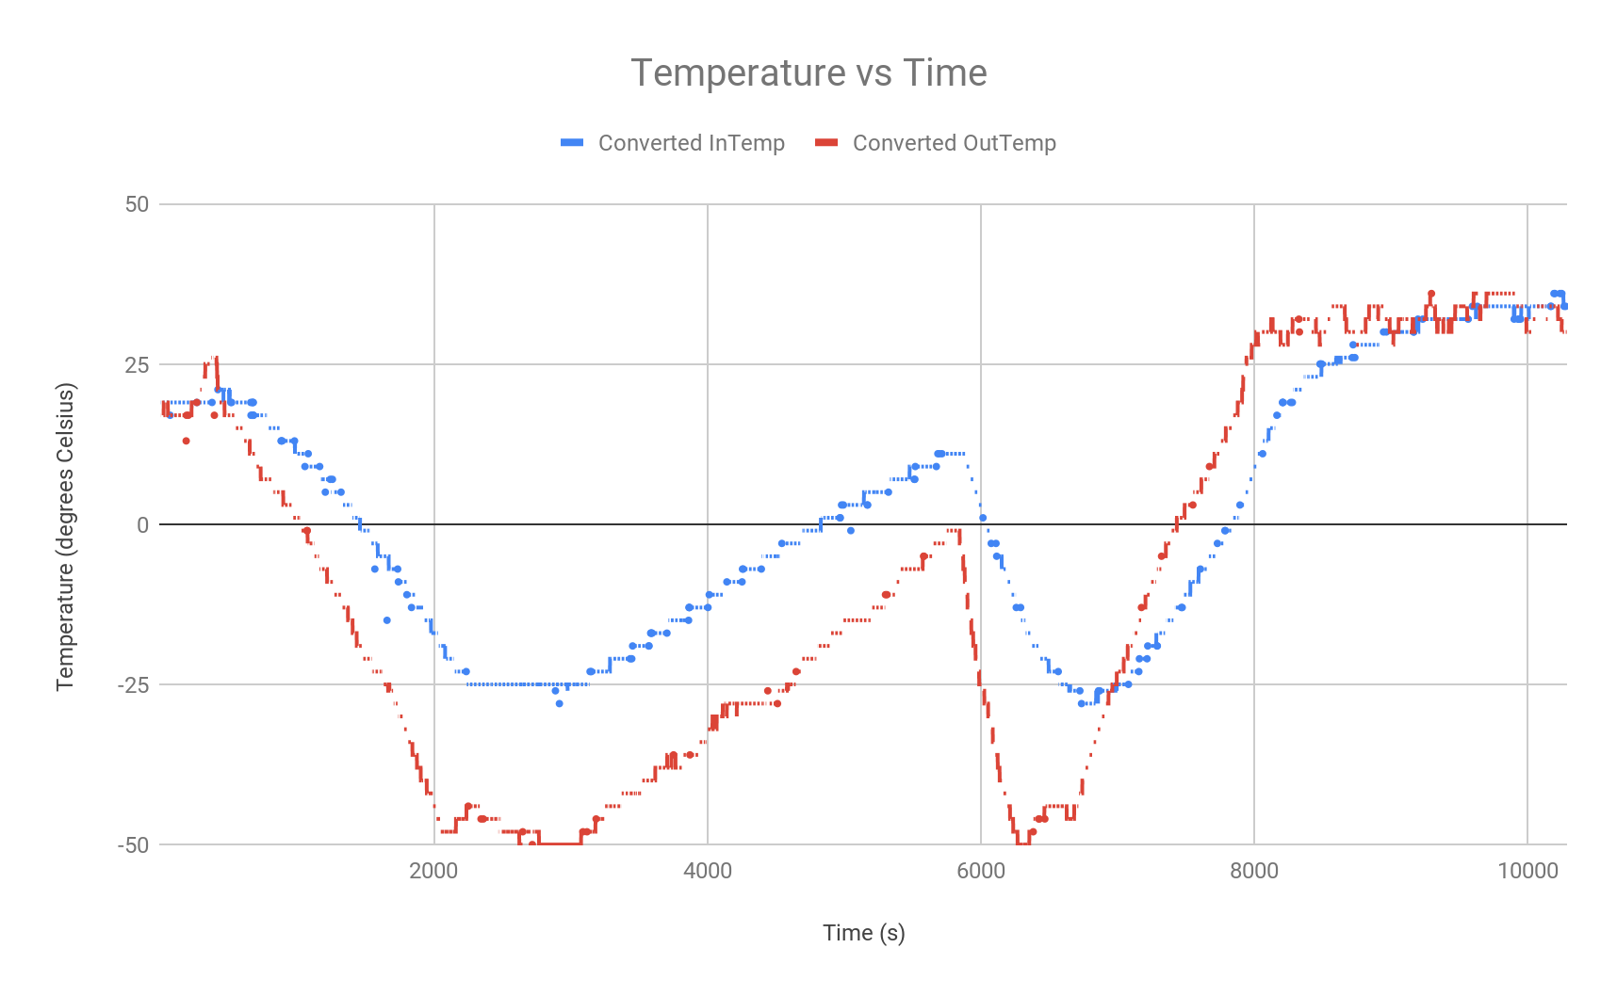
Temperature Sensor:
Fall 2018

Slide 9
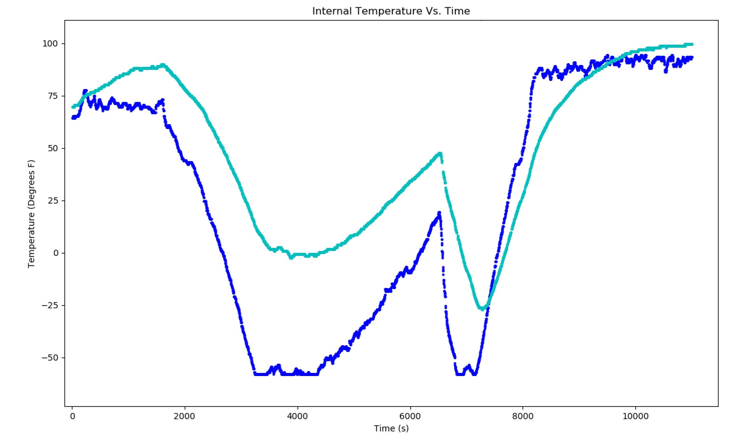
Temperature Sensor:
Spring 2019:

Slide 10
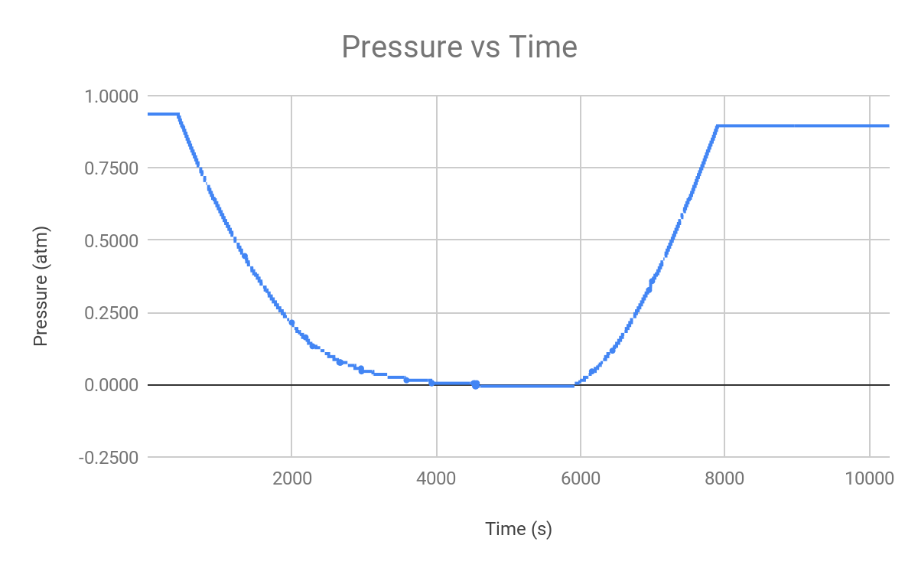
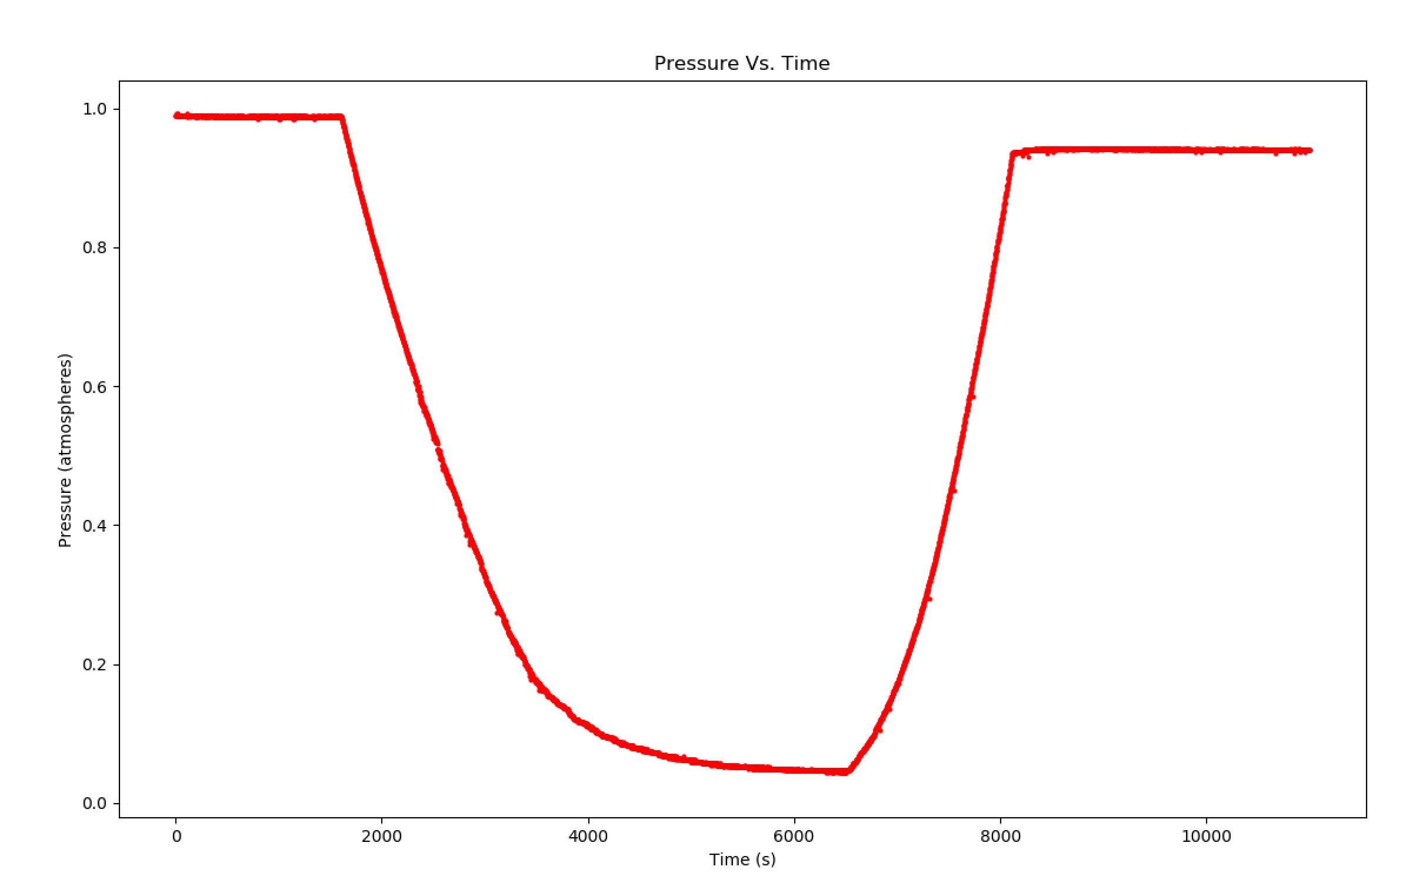
Pressure Sensor:
Fall 2018
Spring 2019

Slide 11
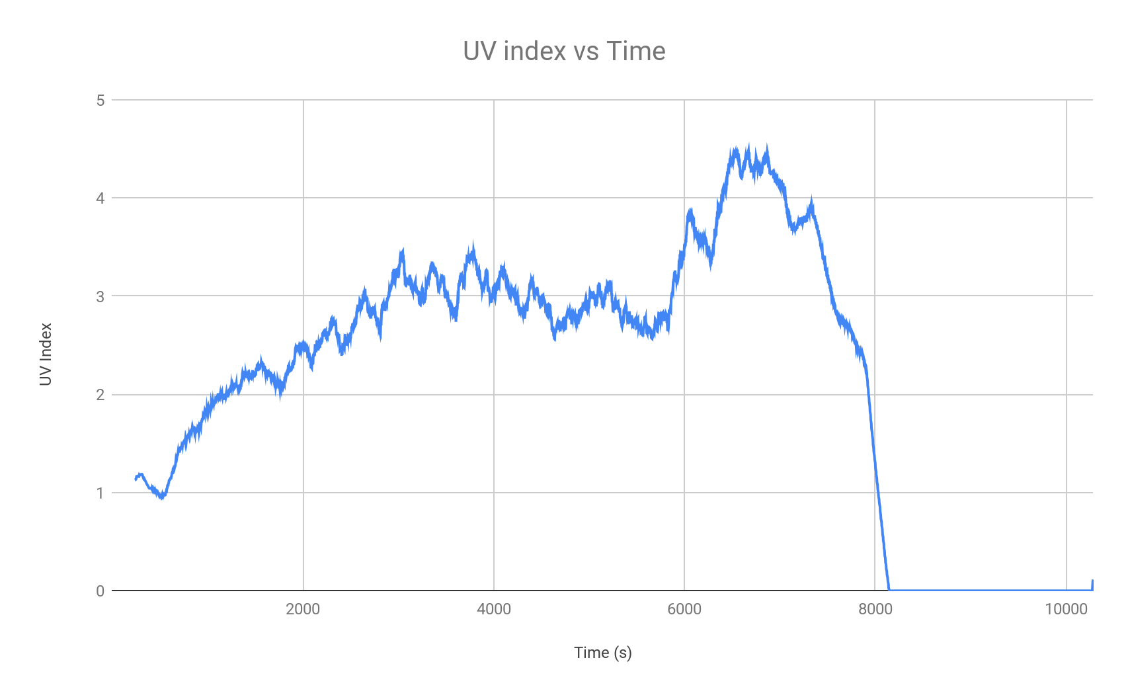
UV Sensor:
Fall 2018:
Spring 2019:
Unreliable data

Slide 12
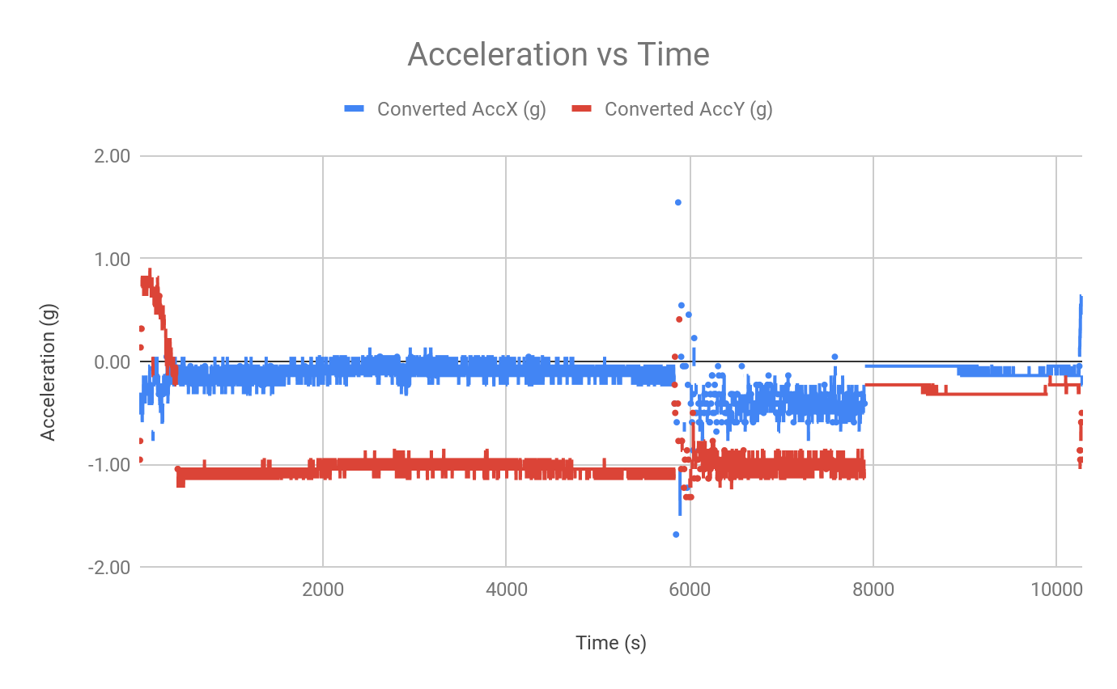
Acceleration Sensor:
Fall 2018:

Slide 13
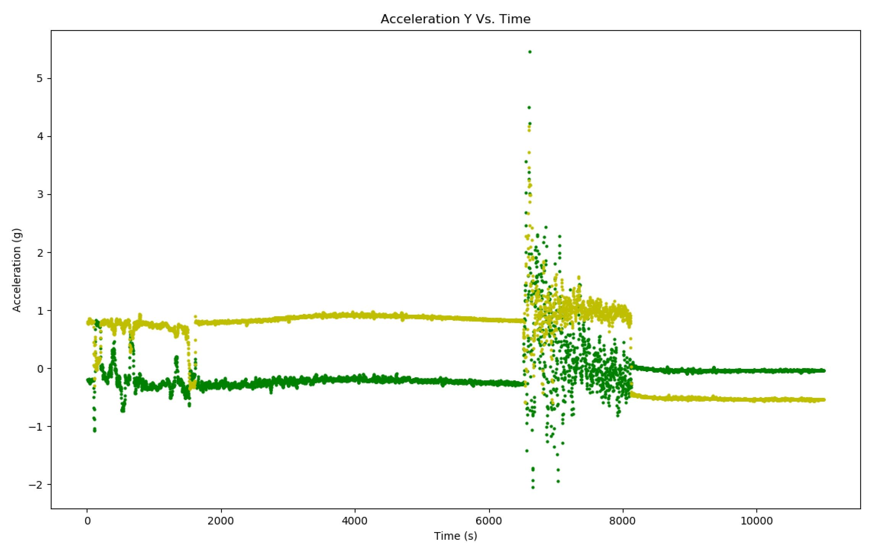
Acceleration Sensor:
Spring 2019:

Slide 14
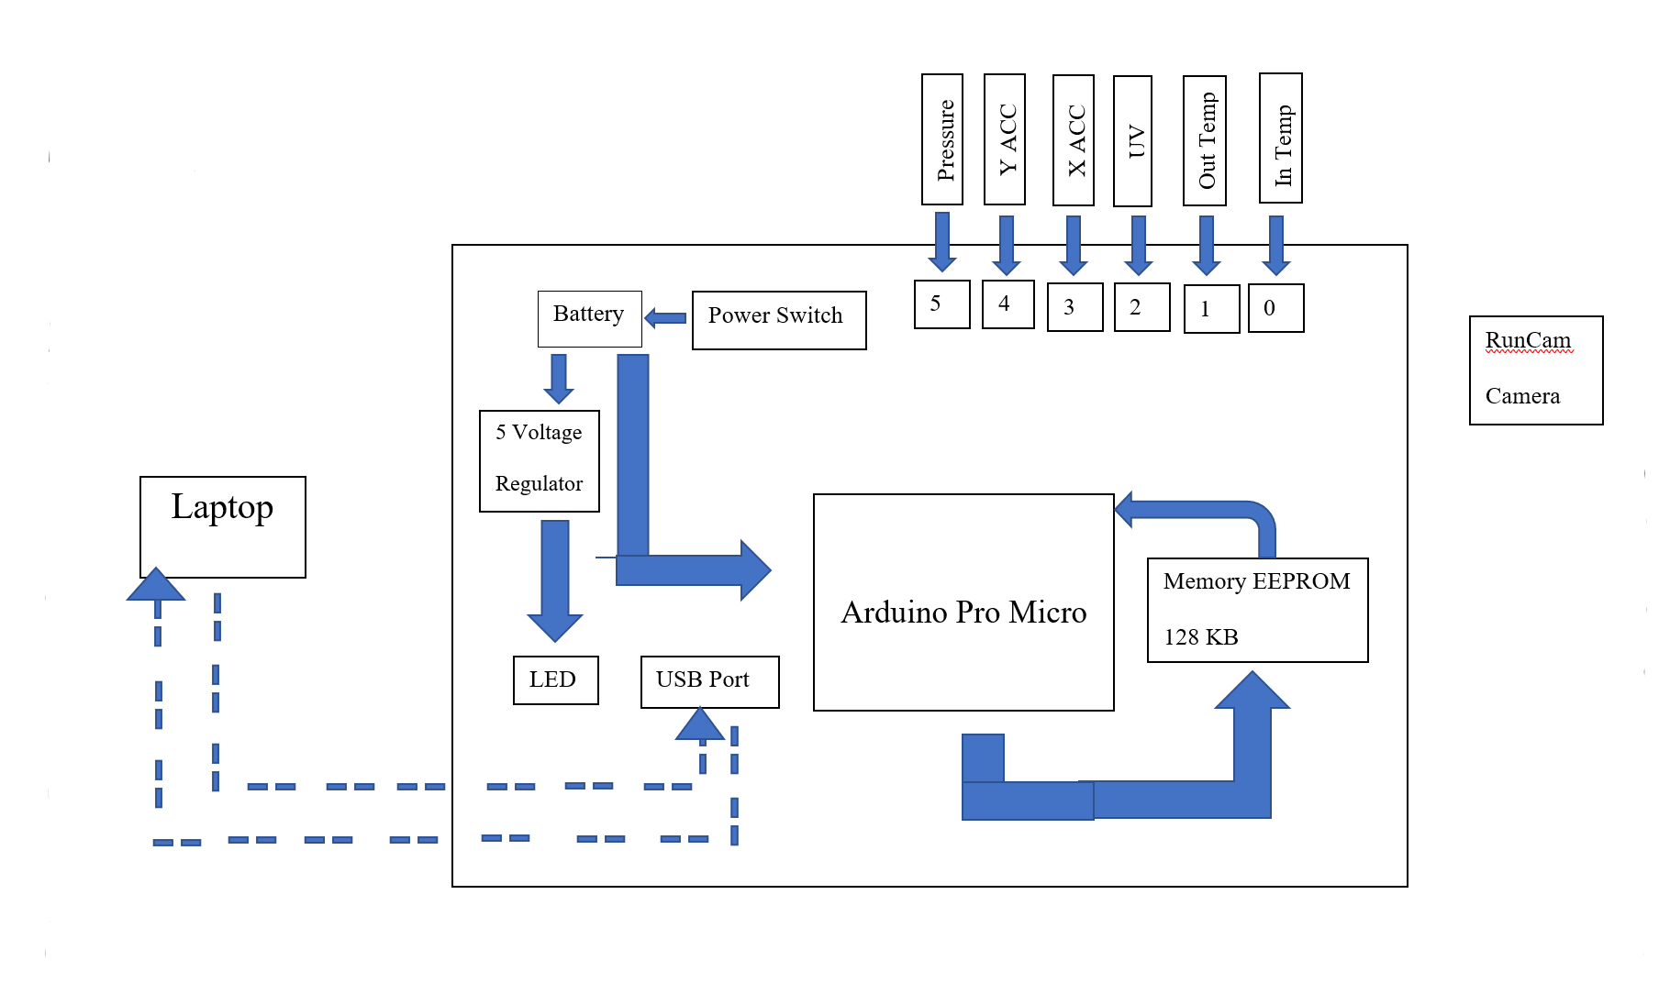
System Block Diagram:
Fall 2018:

Slide 15
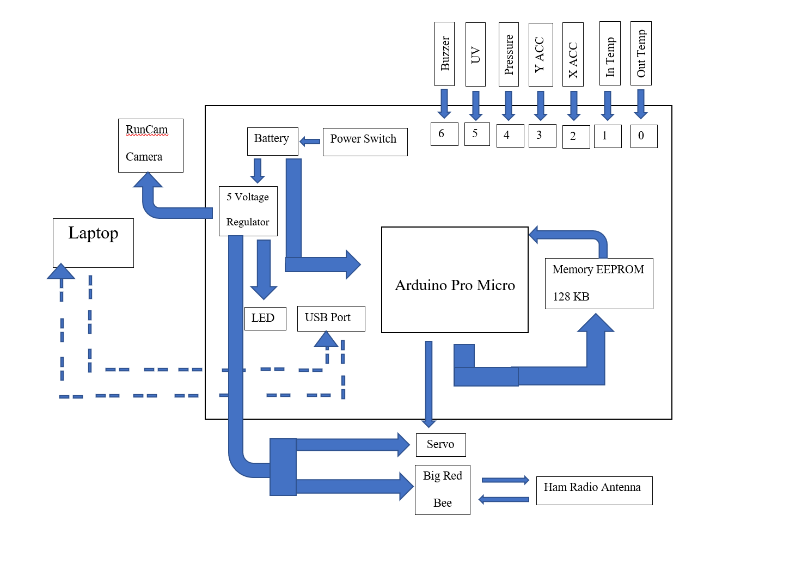
System Block Diagram:
Spring 2019:

Slide 16
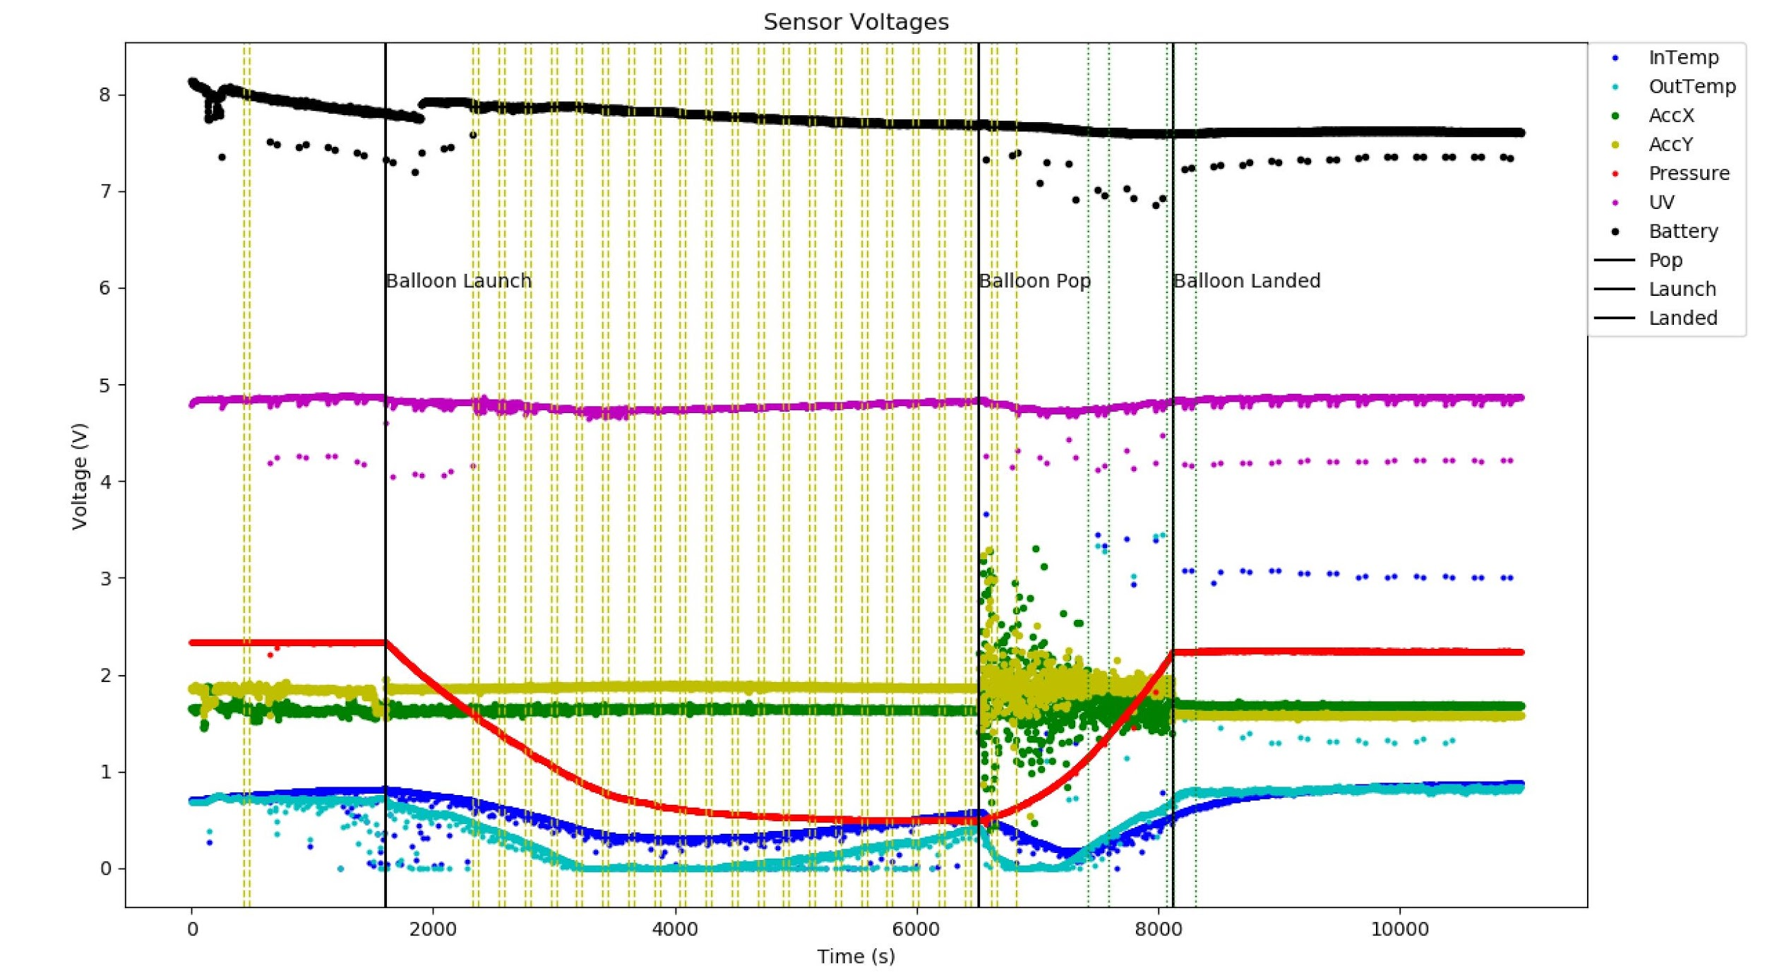
Raw Data:
Vertical Yellow Dashed: Software Resets
Vertical Green Dotted: GPS Transmits

Slide 17
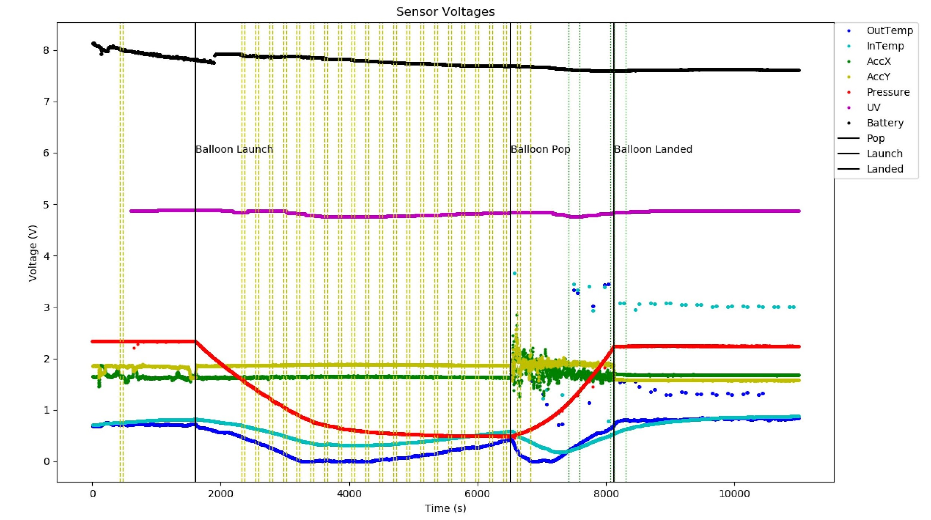
Smoothed Data:
Processed:
Rolling Mean
Rolling Max
Vertical Yellow Dashed: Software Resets
Vertical Green Dotted: Ham Transmitted Points

Slide 18
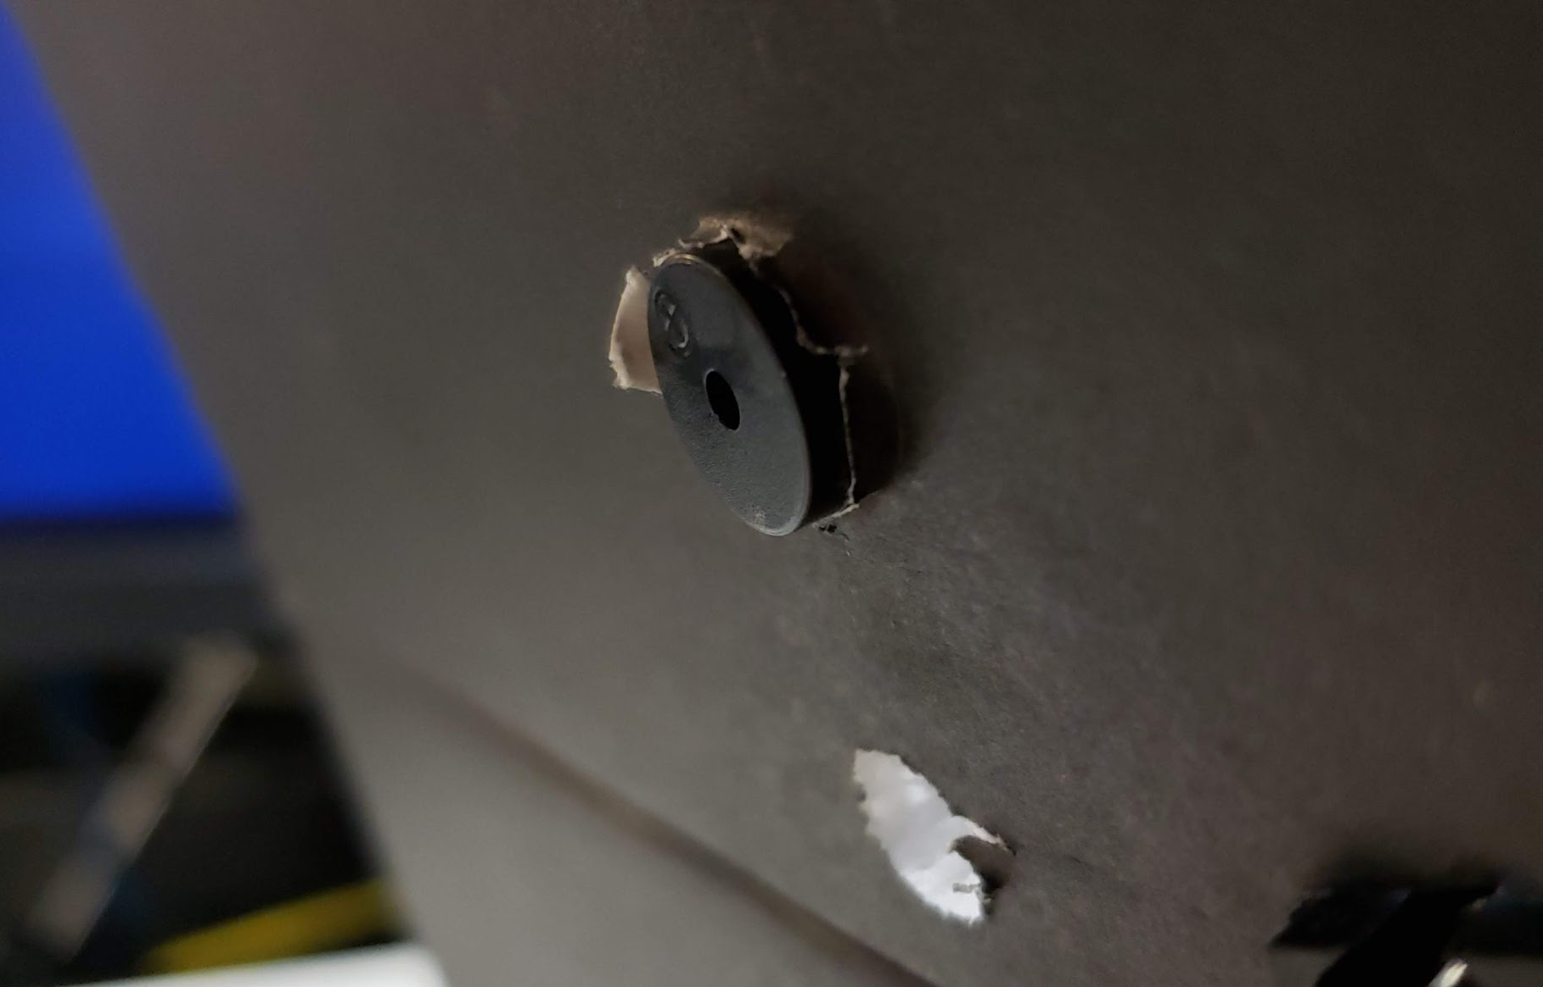
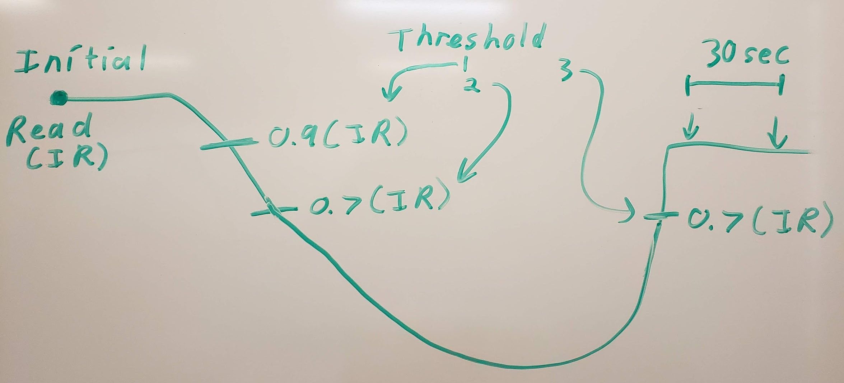
Buzzer & Flag:
Both relied on pressure readings
Buzzer worked!
Started buzzing at 90% of initial pressure
Other payloads contain proof (Thanks UA!)
Flag failed…
Software resets
Parameter resets

Slide 19
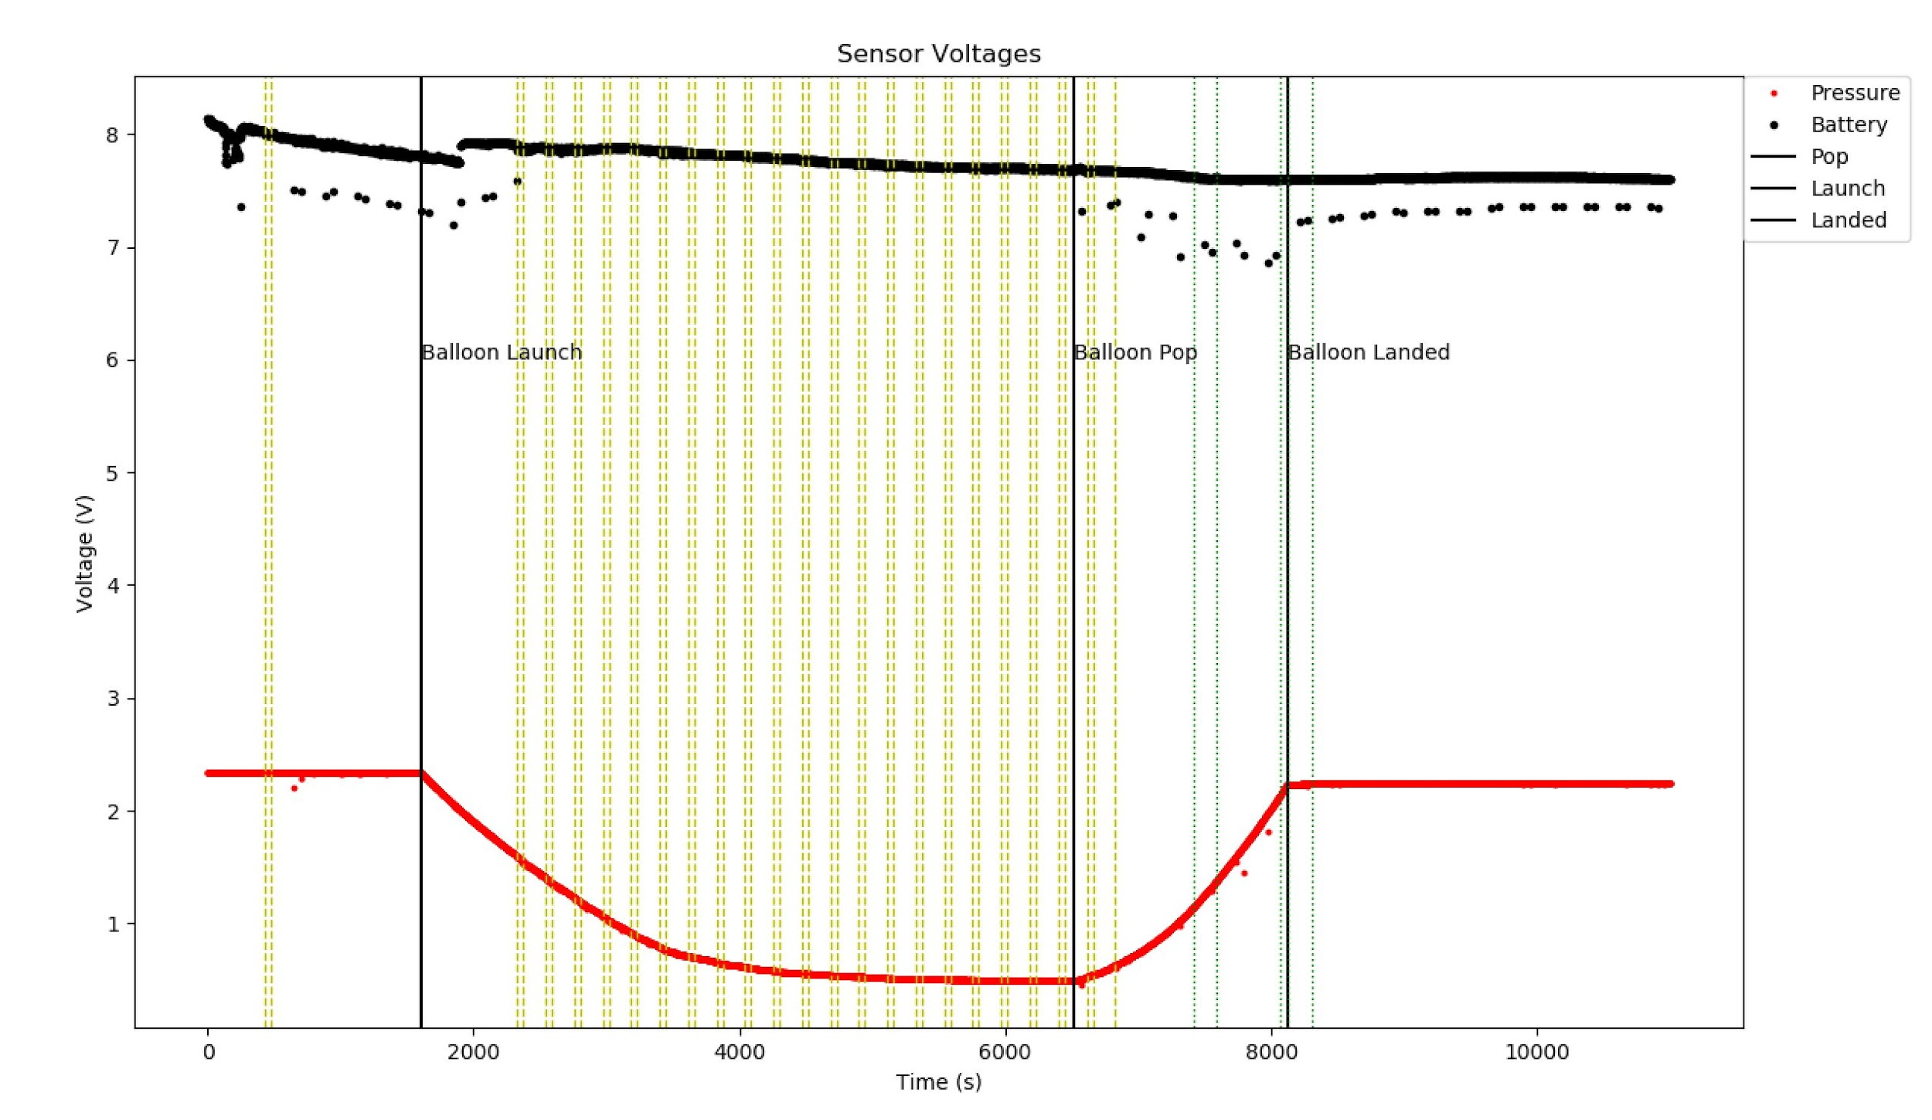
Mystery of the 46 Software Resets:
46 second pairs
2 min 46 seconds apart
Same cadence throughout flight in Battery
Continuous power
Could not recreate in lab
Lesson: Store parameters to EEPROM

Slide 20
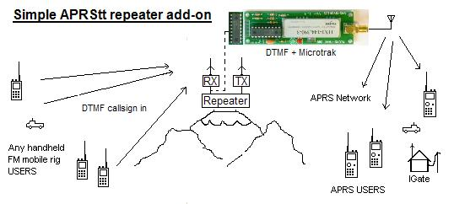
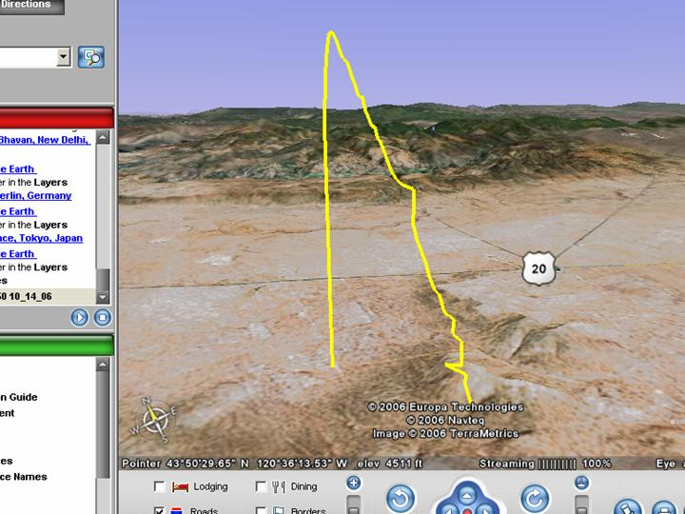
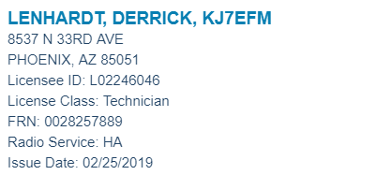
Ham Radio:
End Goal:
APRS Diagram

Slide 21
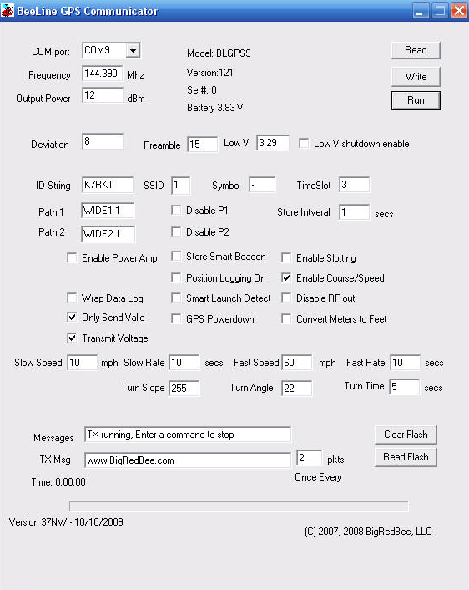
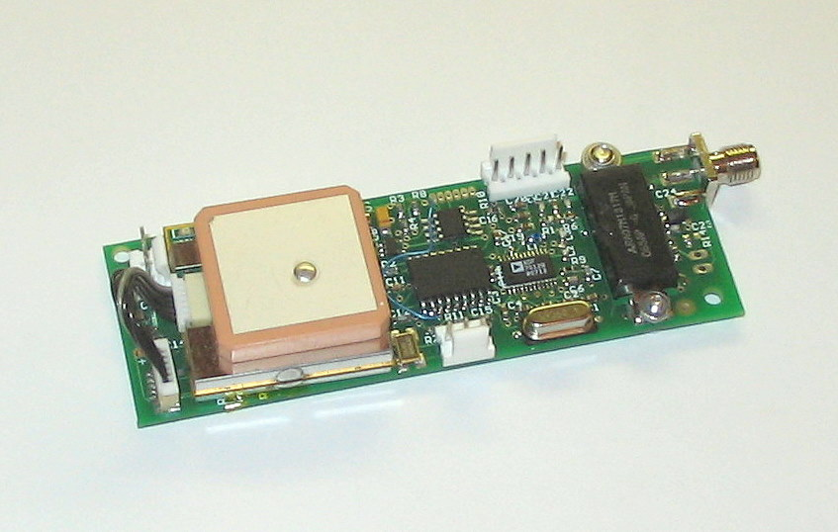
BigRedBee BeeLineGPS:
Operates on ham 2M band

Slide 22
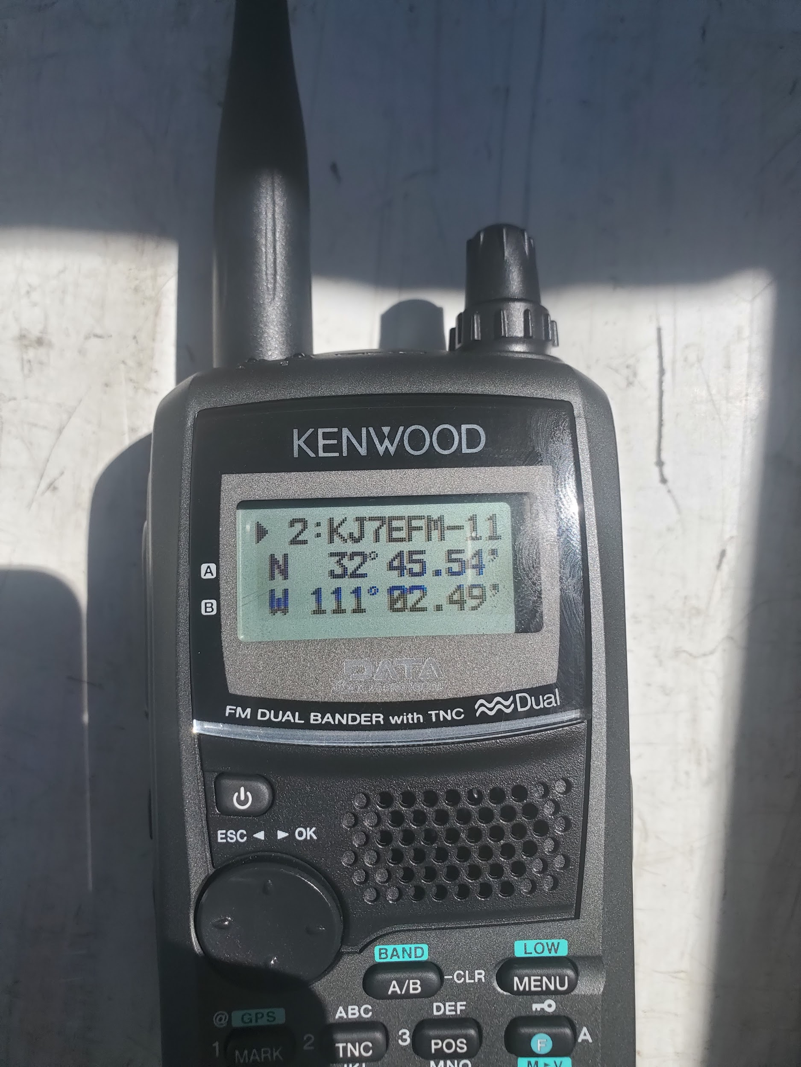
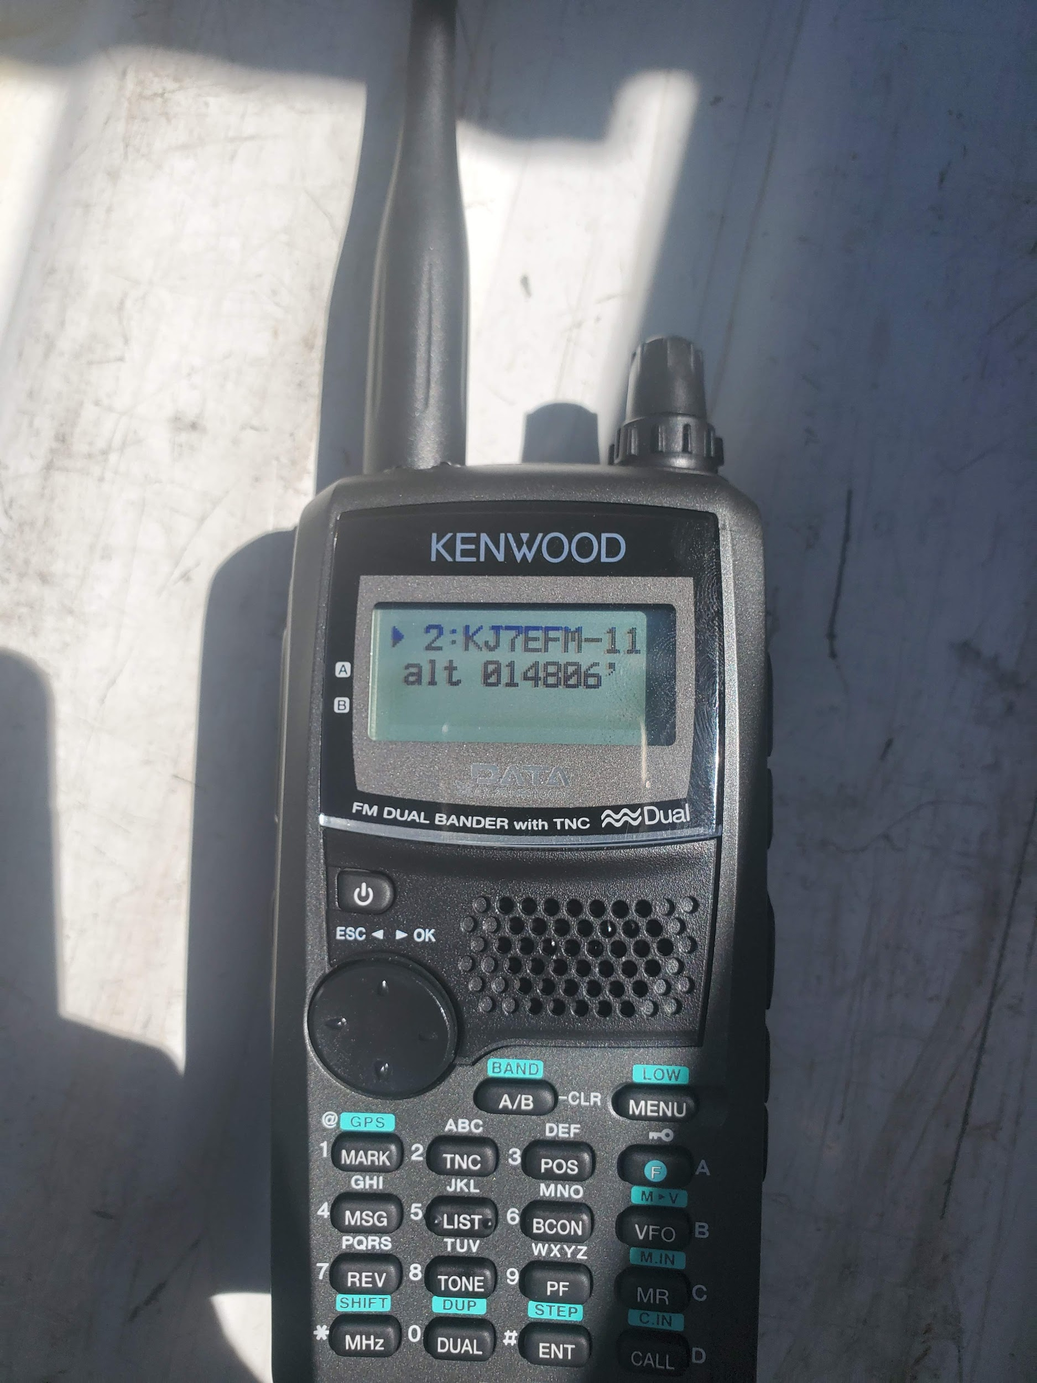
Kenwood TH-D72A:
Handheld ham radio with data receiving capabilities

Slide 23


Data Comparison:

Slide 24
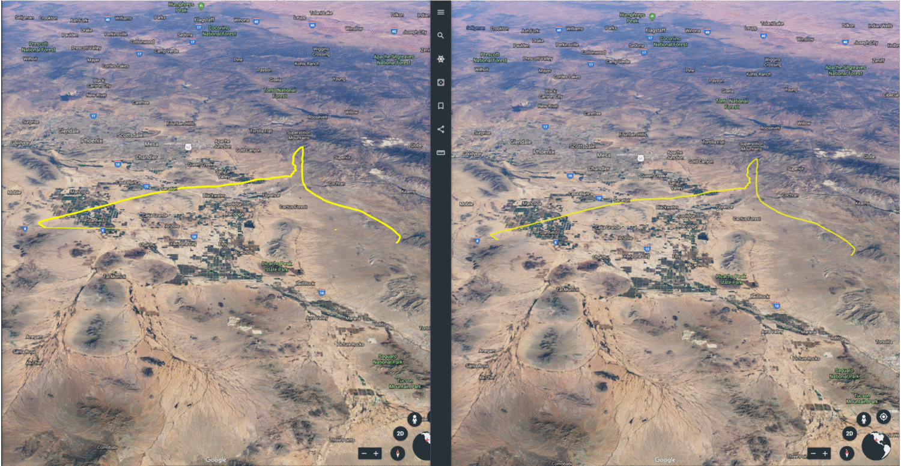
Data Comparison:
BeeLineGPS 2M
ANSR’s GPS Data

Slide 25
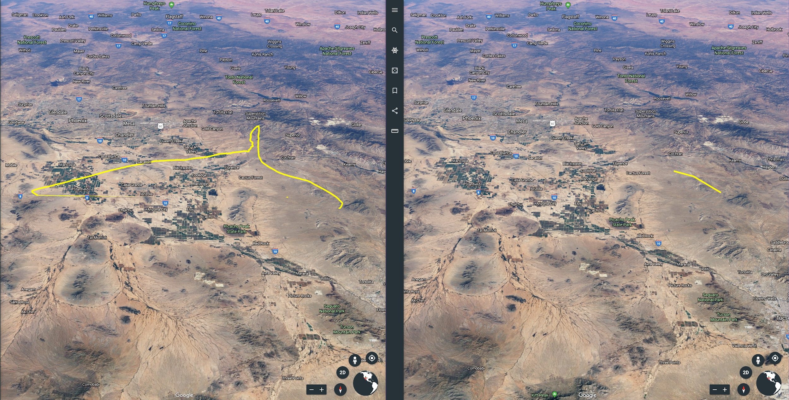
Live GPS Data:
BeeLineGPS
Ham Radio Data

Slide 26
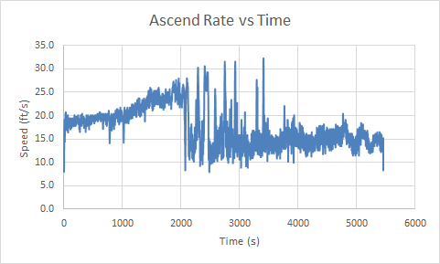
Ham Radio Mysteries:

Slide 27
Ham Radio Mysteries:
Was excessive Speed the problem?
ANSR Beacon 1
Average Ascend Rate - 17 ft/s
Average Descent Rate - 56 ft/s
ANSR Beacon 2
Average Ascend Rate - 17 ft/s
Average Descent Rate - 56 ft/s
Answer: No. The excessive speed did not play a role

Slide 28
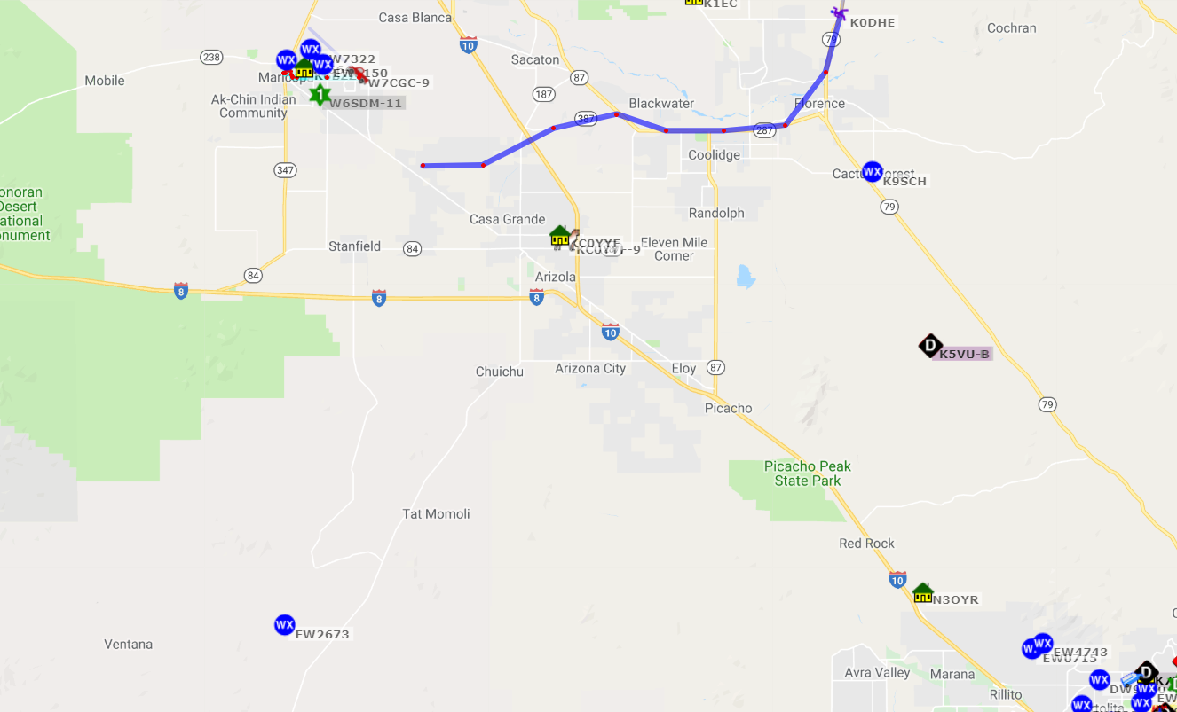
Ham Radio Mysteries:
What we believe of the connection now
Issue 1 - No repeaters in the nearby area
Issue 2 - Inside the vehicle during ascend
The map above shows how there are no repeaters around the area

Slide 29
Thank You!
Dr. Frank
Rick Sparber
Arizona Near Space Research
Arizona Space Grant
ASCEND!
NASA

